Slide 1
Good Coding practices
Swaminathan Venkataraman

Slide 2
Resources Original https://github.com/swaminathan103/Good-coding-practices Shortened https://gg.gg/gcpw

Slide 3
Why best practices?

Slide 4
Why best practices?
Readability and maintainability and easy to collaborate
Productivity - Easier to code, debug and test
Code security - Make the code secure and less prone to security threats
Readability and Code quality

Slide 5
Variable and function naming

Slide 6
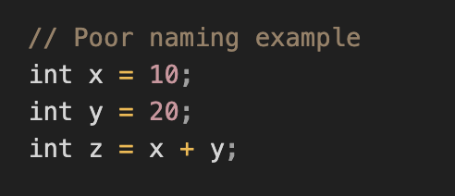
Variable and function naming

Slide 7
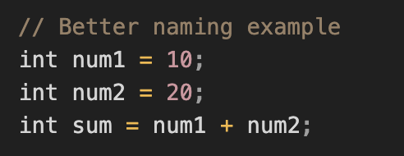
Variable and function naming

Slide 8
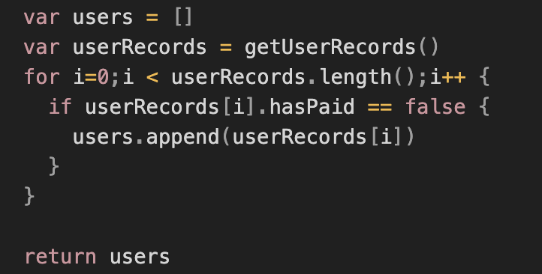
Variable and function naming

Slide 9
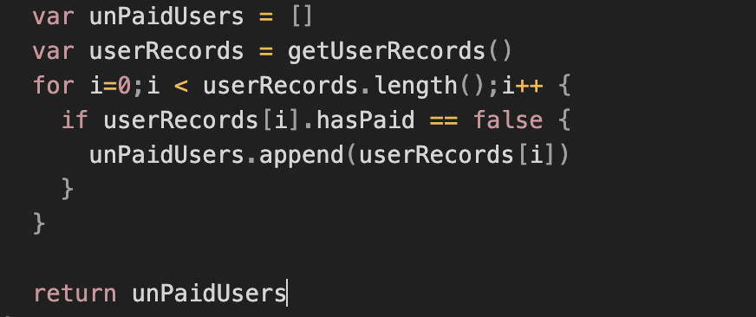
Variable and function naming
Naming with context

Slide 10
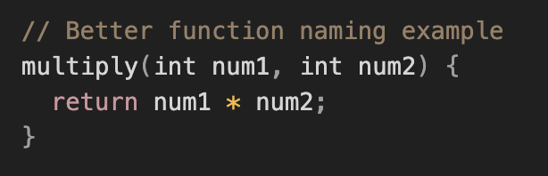
Variable and function naming
Function names

Slide 11
CONSTANTS

Slide 12
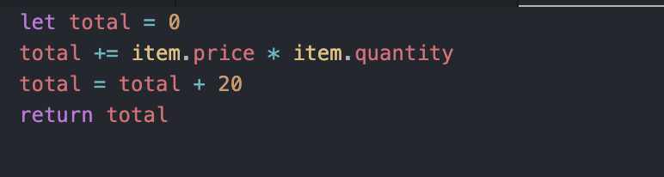
Constants

Slide 13
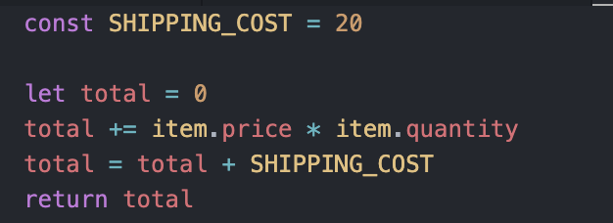
Constants

Slide 14
Constants
The lesser there are string literals and numbers in a code the better
- Not Frequent changes at every place but mainly to Prevent Typos

Slide 15
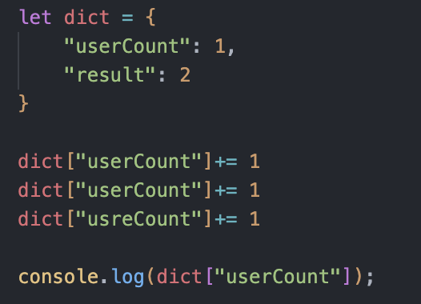
Constants

Slide 16
Code Comments

Slide 17
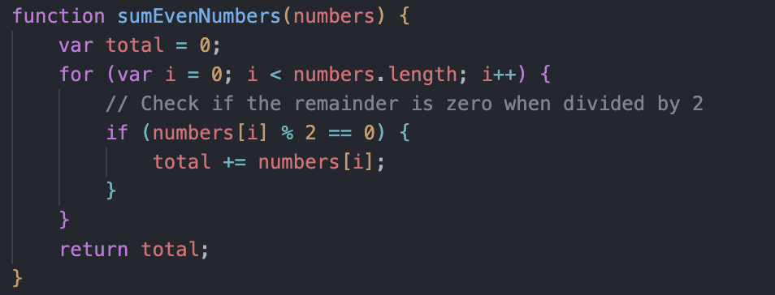
Code Comments

Slide 18
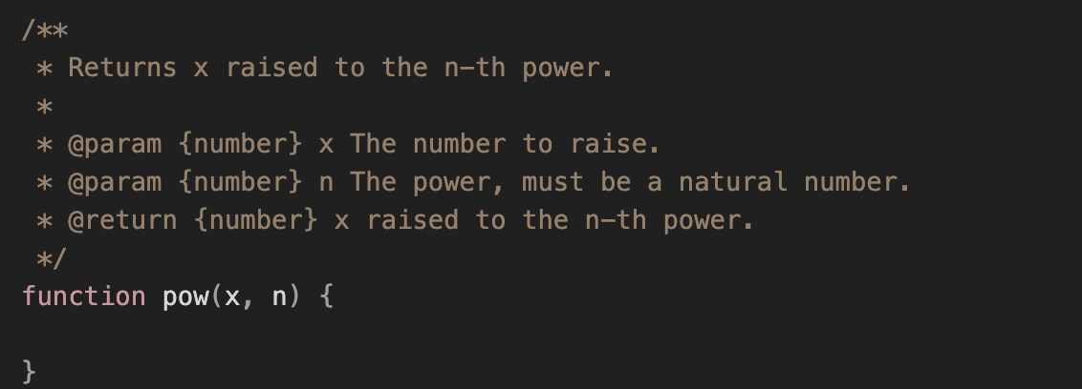
Code Comments

Slide 19
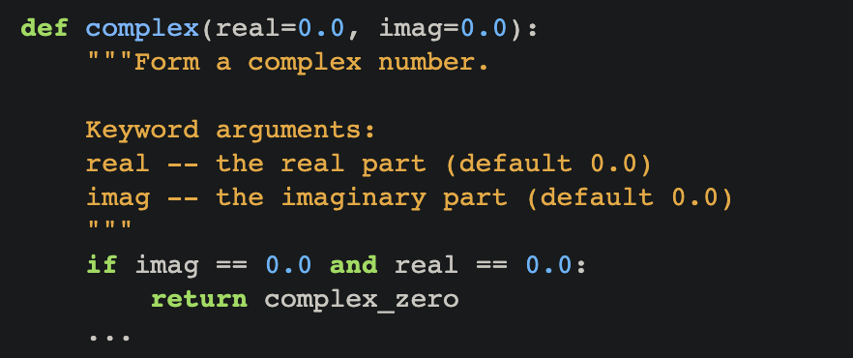
Code Comments
According to PEP257

Slide 20
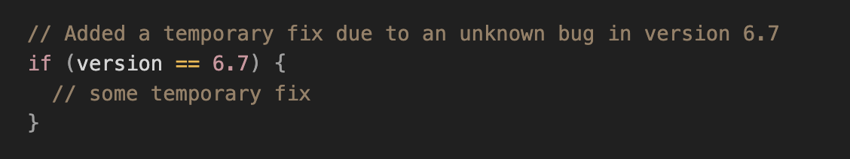
Code Comments
Instruction to fellow programmers

Slide 21
Code Comments
Some keywords in code comments
"NOTE": Used to provide a description of how a piece of code works, especially when it may not be immediately obvious.
"XXX" or "NOTE:XXX": Used to indicate a potential pitfall or issue that may arise when using the code (Kind of giving a heads up).
"HACK" or "HACK:FIXME": Used to denote code that has been written quickly and may not be well-structured or elegant but serves as a workaround to a specific problem or bug.
"FIXME": Used to identify code that is functional but may not be optimal and should be revisited to improve its quality.
"BUG": Used to indicate that there is a problem with the code that needs to be fixed.
"TODO": Used to identify a piece of code that still needs to be written, typically for cases where the coder is skipping over something temporarily.

Slide 22
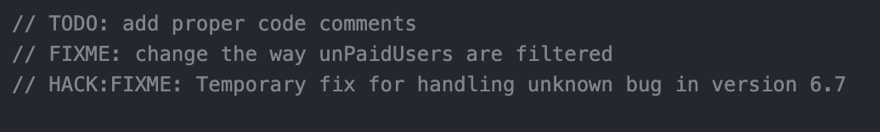
Code Comments

Slide 23
DRY – don’t repeat yourself

Slide 24
DRY – don’t repeat yourself

Slide 25
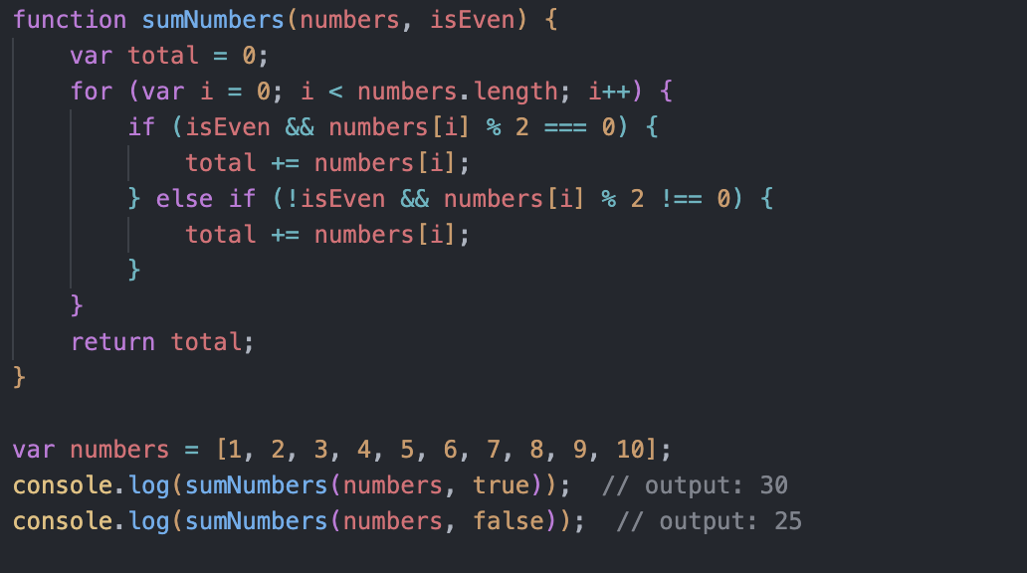
DRY – don’t repeat yourself

Slide 26
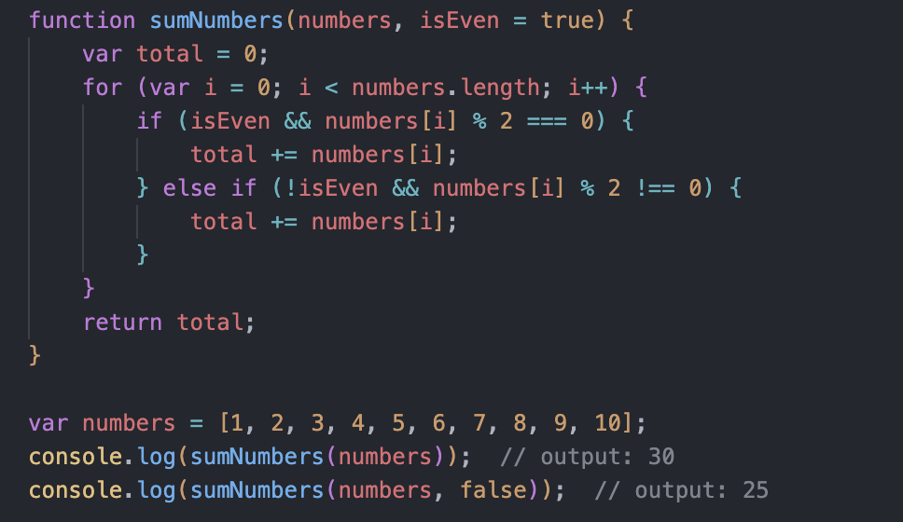
DRY – don’t repeat yourself

Slide 27
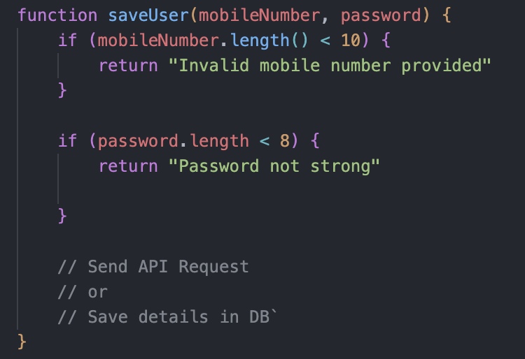
DRY – don’t repeat yourself
Make sure that the function serves only a single purpose

Slide 28
Exercise – Canvote()

Slide 29
Exercise
CanVote(age)
Write a function that checks if the person can vote or not based on age
Age will be passed as an argument
Return "Cannot vote, Sorry!” if the age is less than 18
Return "You can vote!" if the age is greater than 18

Slide 30
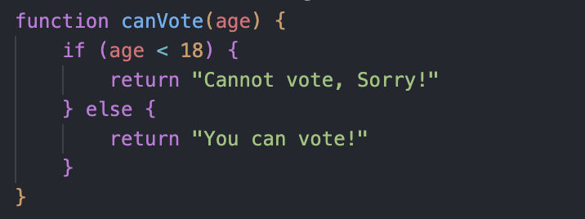
Exercise

Slide 31
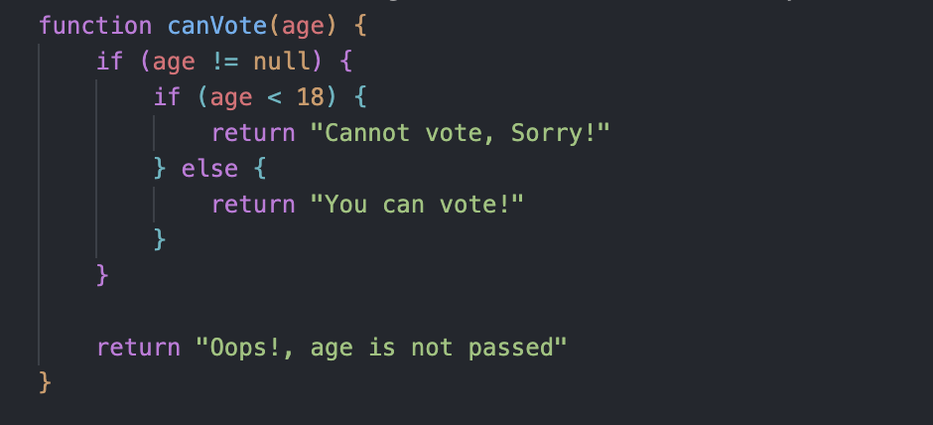
Exercise – With error check

Slide 32
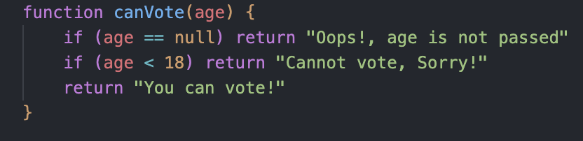
Exercise – better version

Slide 33
Deep Nesting

Slide 34
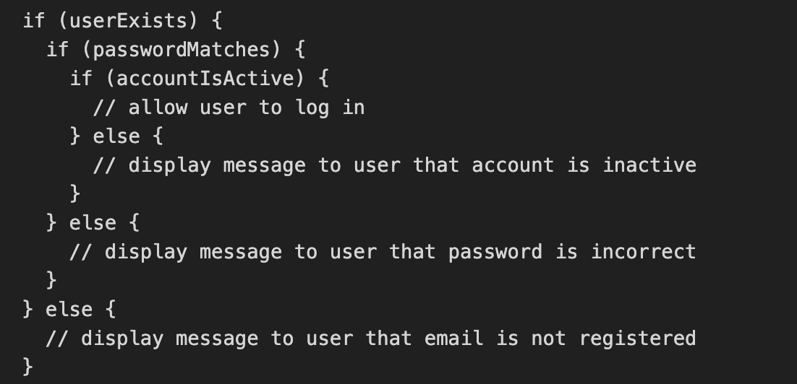
Deep Nesting

Slide 35
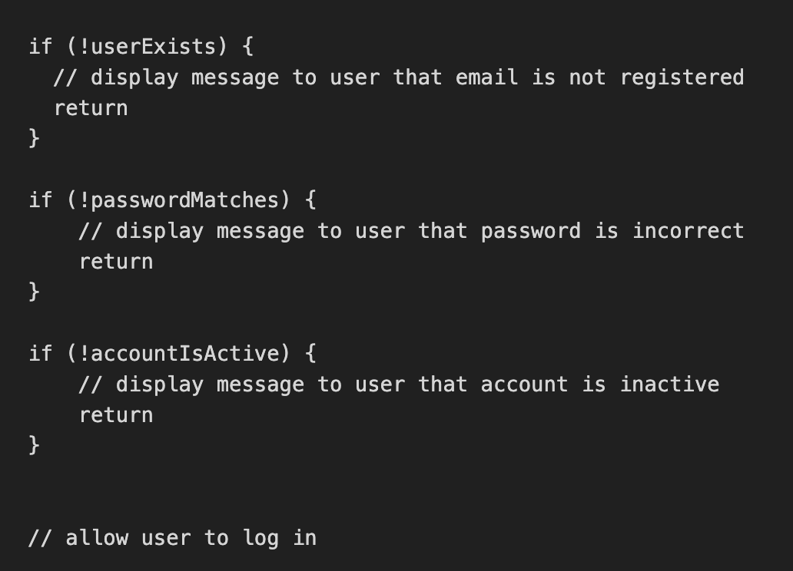
Deep Nesting
Use guard clause to prevent additional nesting

Slide 36
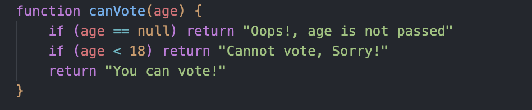
Deep Nesting
Use guard clause to prevent additional nesting

Slide 37
Error handling

Slide 38
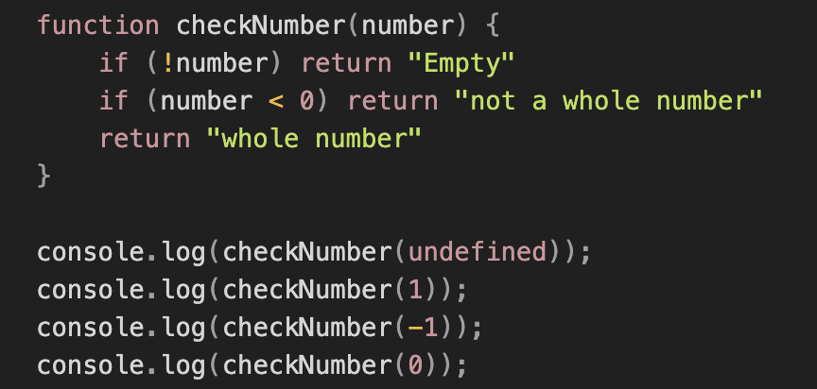
Error handling
Check for null or undefined cases
not operator over zero

Slide 39
Code security

Slide 40
Code security
Don’t add passkeys in the constant file
Don’t push production pass key files
Make sure the code is not vulnerable to any sort of attacks like script injection etc.

Slide 41
EXErcise - BMI

Slide 42
EXErcise - BMI
BMI Calculator
Calculate BMI based on height and weight
Formula - weight / (height * height)
Print the bmi value

Slide 43
EXErcise - BMI
Print advice based on the bmi value
Bmi less than 18.5 – underweight
Bmi between 18.5 and 24.9 – fit
Bmi greater than 24.9 – overweight

Slide 44
EXErcise - BMI
Print Color based on bmi advice
If fit – green
Other two cases - red

Slide 45
EXErcise - BMI
Print Complete details
Value, advice and the color
Print details based on an Option
1 – Print bmi value only
2 – Print bmi advice only
3 – Print complete details

Slide 46
EXErcise - BMI
How often was a function changed?
Was a function changed for any reason other than the intended logic?

Slide 47
Design Pattern

Slide 48
Design Pattern
MVC
M – Model – Contains the Data
V – View – Responsible for handling the view
C – Controller – Handles Business Logic

Slide 49
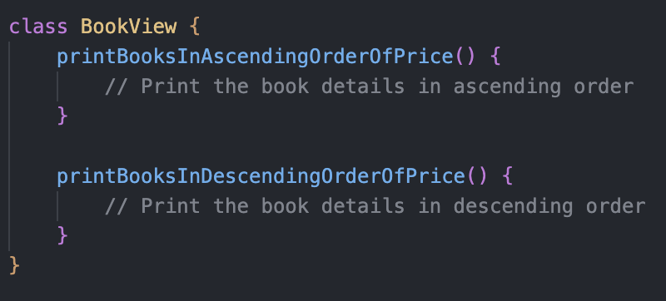
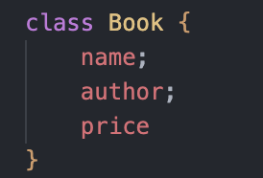
Design Pattern
Model
View

Slide 50
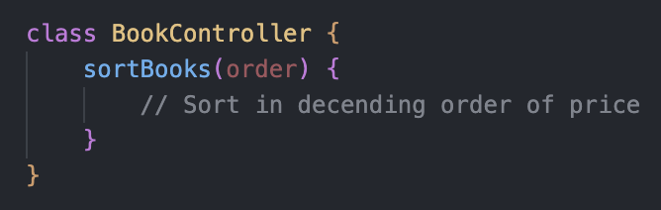
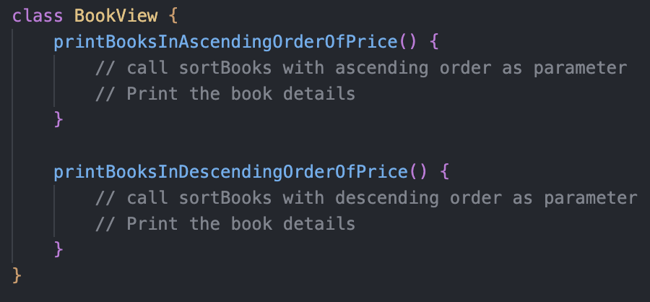
Design Pattern
Controller
View

Slide 51
Exercise – using MVC

Slide 52
Summary

Slide 53
summary
Variable and function naming
Constants
Code Comments
DRY – Don’t Repeat Yourself
Error handling
Deep Nesting– Guard Clause
Code Security
Design Pattern – MVC

Slide 54
Thank you!

